Slide 1
System Programming
Macros and Macro Processors
Notes:
lec00-outline

Slide 2
Course Outline
Macro Instructions
Features of a Macro facility
Implementation of Two pass Macro

Slide 3
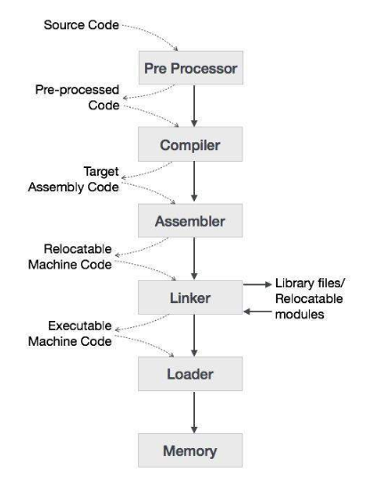
Language processing system

Slide 4
Macors
Assembly language programmer often finds it necessary to repeat some blocks of code many times in program.
Blocks may consists of code to save or exchange sets of registers such as to perform a series of arithmetic operation.
Macro instruction (often called macros) are single line abbreviations for group of instructions.
Programmer define a single word or instruction to represent a block of code.
Macro processing assembler will substitute the entire block, every time at the occurrence of one this one line macro instruction in the program.
We will treat the use of macro instruction in the programming and implementation of macros within an assembler.

Slide 5
Continue..
Macro are used to provide a program generation facility through macro expansion.
Many programming language provide built in facilities for writing macros. E.g. Ada, C, C++.
Higher version of processor family also provide such facility.
A macro is a unit of specification for program generation through expansion.
“The use of macro name with a set of actual parameters is replaced by some code generated from its body, this is called macro expansion.”
Dr. Mohit kumar (System Programming)

Slide 6
Macro and Macro processor
Macro:- – Macro instructions are single line abbreviations for group of instructions. – Using a macro, programmer can define a single “instruction” to represent block of code. – Ex: #define in C and MACRO <Macro Name> in Assembly language.
Macro processor- – Macro instructions are an extension of the basic assembly language that can simplify debugging and program modification during translation. – To process macro instructions , most assembler use preprocessors known as Macro processors
Dr. Mohit kumar (System Programming)

Slide 7
Advantages and Disadvantages
The advantages of using macro are as follows:
– Simplify and reduce the amount of repetitive coding.
– Reduce the possibility of errors caused by repetitive coding – Make an assembly program more readable.
The disadvantage of the macro is the size of the program. The reason is, the pre-processor will replace all the macros in the program by its real definition prior to the compilation process of the program.
Dr. Mohit kumar (System Programming)

Slide 8
Applications of Macro
when assembly language programming was commonly used to write programs for digital computers.
the use of macro instructions was initiated for two main purposes:
to reduce the amount of program coding that had to be written by generating several assembly language statements from one macro instruction.

Slide 9
Difference between MACRO and PROCEDURE
MACROS | PROCEDURE
The corresponding machine code is written every time a macro is called in a program. | The Corresponding m/c code is written only once in memory.
Program takes up more memory space. | Program takes up comparatively less memory space.
No transfer of program counter. | Transferring of program counter is required.
No overhead of using stack for transferring control. | Overhead of using stack for transferring control.
Execution is fast | Execution is slow
Assembly time is more. | Assembly time is comparatively less.
More advantageous to the programs when repeated group of instruction is too short. | More advantageous to the programs when repeated group of instructions is quite large.

Slide 10
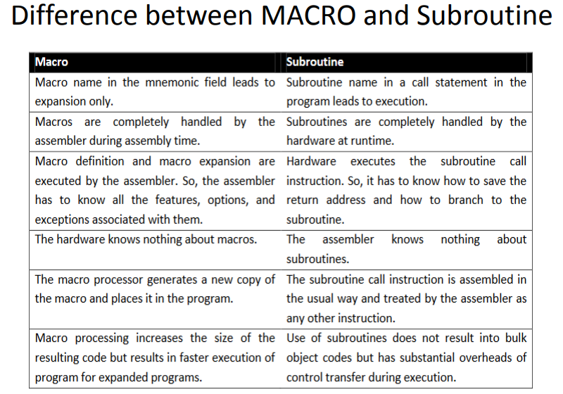

Slide 11
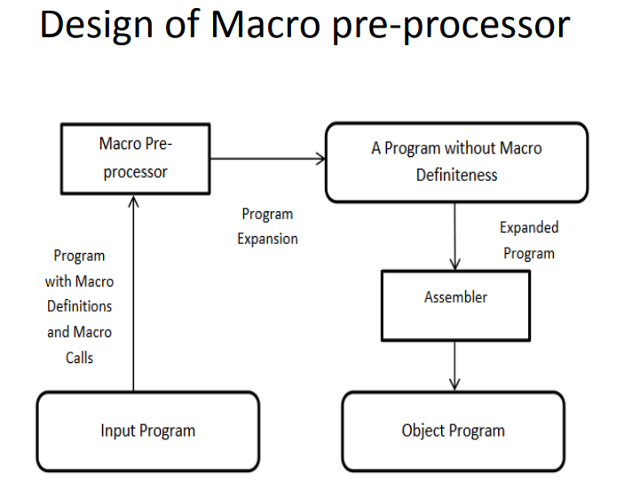

Slide 12
Example of macro instruction
………………. ………. …………
A 1, DATA Add contents of data to register 1
A 2, DATA Add contents of data to register 2
A 3, DATA Add contents of data to register 3
…………………. ………… ………..
A 1, DATA Add contents of data to register 1
A 2, DATA Add contents of data to register 2
A 3, DATA Add contents of data to register 3
………. …………. …………………..
DATA DC F’5’
In the above program the sequence occurs twice
A 1, DATA Add contents of data to register 1
A 2, DATA Add contents of data to register 2
A 3, DATA Add contents of data to register 3
Dr. Mohit kumar (System Programming)

Slide 13
Example of macro instruction
A macro facility permits us to attach a name to this sequence and to use this name in its place.
We can invert a macro language that allows us to specify the above as a macro definition.
We attach a name to a sequence by means of macro instruction definition, which is formed in the following manner:
Start of definition .. .………. …. . MACRO
Macro name ……………. . .. . [ ]
Sequence to be abbreviated ….. . . { …
End of definition ……………… MEND
Dr. Mohit kumar (System Programming)

Slide 14
Example of macro instruction
Once the macro has been defined, the use of the macro name as an operation mnemonic in an assembly program is equivalent to the use of corresponding instruction sequence. Our example might be rewritten as:
Source
MACRO
INCR //name of macro
A 1, DATA Add contents of data to register 1
A 2, DATA Add contents of data to register 2
A 3, DATA Add contents of data to register 3
MEND
……….. Expended source
INCR => process of replacement A 1, DATA
……………. A 2, DATA
INCR A 3, DATA
DATA DC F’5’
Dr. Mohit kumar (System Programming)

Slide 15
Macro instruction arguments
In this case of macro processor replaces each macro call with the lines.
A 1, DATA Add contents of data to register 1
A 2, DATA Add contents of data to register 2
A 3, DATA Add contents of data to register 3
This macro facility lacks flexibility
There is no way for a specific macro call to modify the coding that replace it.
An important extension of this facility consists of providing for arguments, or parameters, in macro calls.
Corresponding macro dummy arguments will appear in macro definitions.
Dr. Mohit kumar (System Programming)

Slide 16
Features of Macro Facility
Example 2
A 1, DATA 1
A 2, DATA 1
A 3, DATA 1
………..
A 1, DATA 2
A 2, DATA 2
A 3, DATA 2
DATA 1 DC F’5’
DATA 2 DC F’10’
In this case, instruction sequence are very similar but not identical.
First sequence perform the operation using DATA1 as operand, while second using DATA2
Dr. Mohit kumar (System Programming)

Slide 17
Continue..
They can be considered to perform the same operation with a variable parameter, or argument. Such a parameter is called a macro instruction argument or “dummy argument”.
Source
MACRO Macro INCR has one argument
INCR &ARG
A 1, &ARG
A 2, &ARG
A 3, &ARG
………..
INCR DATA1 use DATA1 as operand
…………….
INCR DATA2 use DATA2 as operand
DATA1 DC F’5’
DATA2 DC F’10’
Dr. Mohit kumar (System Programming)

Slide 18
Continue..
It is possible to supply more than one argument in a macro call.
Each argument must correspond to a definition (“dummy”) argument on the macro name line of the macro definition.
When a macro call is processed, the argument supplied are substituted for the respective dummy arguments in the macro definition.
Dr. Mohit kumar (System Programming)

Slide 19
Example 3
………………………………….
LOOP 1 A 1, DATA1
A 2, DATA2
A 3, DATA3
……………. ……………
LOOP 2 A 1, DATA3
A 2, DATA2
A 3, DATA1
………. ………… ………….
DATA1 DC F’5’
DATA2 DC F’10’
DATA3 DC F’15’
In this case the operands in the common sequence are different, as are the labels on the first cards of the sequences. This program could be written as
Dr. Mohit kumar (System Programming)

Slide 20
Continue..
SOURCE
……………………………………
MACRO
&LAB INCR &ARG1, &ARG2, &ARG3
&LAB A 1, &ARG1
A 2, &ARG2
A 3, &ARG 3
MEND
……….. …………………………..
LOOP1 INCR DATA1, DATA2, DATA3
………………………………………………………
LOOP2 INCR DATA3, DATA2, DATA1
…………….
DATA1 DC F’5’
DATA2 DC F’10’
DATA3 DC F’15’
Dr. Mohit kumar (System Programming)

Slide 21
Continue..
Another encoding of example 3 is given below:
Source
MACRO
INCR &ARG1, &ARG2, &ARG3, &LAB
&LAB A 1, &ARG1
A 2, &ARG2
A 3, &ARG 3
MEND
……….. …………………………..
INCR DATA1, DATA2, DATA3, LOOP1
………………………………………………………
INCR DATA3, DATA2, DATA1, LOOP2
Where LOOP 1 A 1, DATA1
A 2, DATA2
A 3, DATA3
LOOP 2 A 1, DATA3
A 2, DATA2
A 3, DATA1
Dr. Mohit kumar (System Programming)

Slide 22
Design issues of Macro preocessor
Flexible data structures and databases
Attributes of macro arguments/parameter name
Default arguments/ formal parameter value at macro definition time
Numeric values of arguments/ actual parameter value at macro call
Comments in macros
Dr. Mohit kumar (System Programming)

Slide 23
Features of macro processor
• Associating macro parameters with their arguments
• Delimiting macro parameters
• Directives related to arguments
• Automatic label generation
• Machine independent features

Slide 24
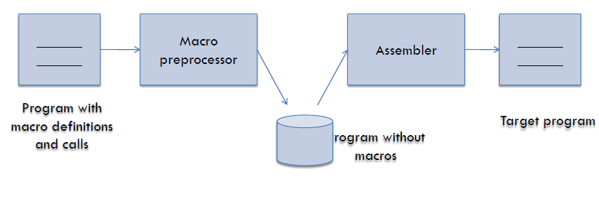
DESIGN OF A MACRO PREPROCESSOR
The macro preprocessor accepts an assembly program containing definitions and calls and translates it into an assembly program which does not contain any macro definition or call.
Dr. Mohit kumar (System Programming)

Slide 25
Functions of Macro preprocessor
Macro processor will perform the following tasks-
– Identifies macro definitions and calls in the program.
– Determines formal parameters and their values.
– Keeps track of the values of expansion time variables and sequencing symbols declared in a macro.
– Handles expansion time control flow and performs expansion of model statements.
Dr. Mohit kumar (System Programming)

Slide 26
Implementation of Two pass Macro
General Design Steps
• Step 1: Specification of Problem:-
• Step 2 Specification of databases:-
• Step 3 Specification of database formats
• Step 4 : Algorithm
Dr. Mohit kumar (System Programming)

Slide 27
Specify the problem
In Pass-I the macro definitions are searched and stored in the macro definition table and the entry is made in macro name table
• In Pass-II the macro calls are identified and the arguments are placed in the appropriate place and the macro calls are replaced by macro definitions.
Dr. Mohit kumar (System Programming)

Slide 28
Specification of databases:
Pass 1:-
• The input macro source program.
• The output macro source program to be used by Pass2.
• Macro-Definition Table (MDT), to store the body of macro defns .
• Macro-Definition Table Counter (MDTC), to mark next available entry MDT.
• Macro- Name Table (MNT), used to store names of macros.
• Macro Name Table counter (MNTC), used to indicate the next available entry in MNT.
• Argument List Array (ALA), used to substitute index markers for dummy arguments before storing a macro-defns .
Dr. Mohit kumar (System Programming)

Slide 29
Specification of databases:-
Pass 2:-
• The copy of the input from Pass1.
• The output expanded source to be given to assembler.
• MDT, created by Pass1. • MNT, created by Pass1.
• Macro-Definition Table Pointer (MDTP), used to indicate the next line of text to be used during macro expansion.
• Argument List Array (ALA), used to substitute macro call arguments for the index markers in the stored macro-defns
Dr. Mohit kumar (System Programming)

Slide 30
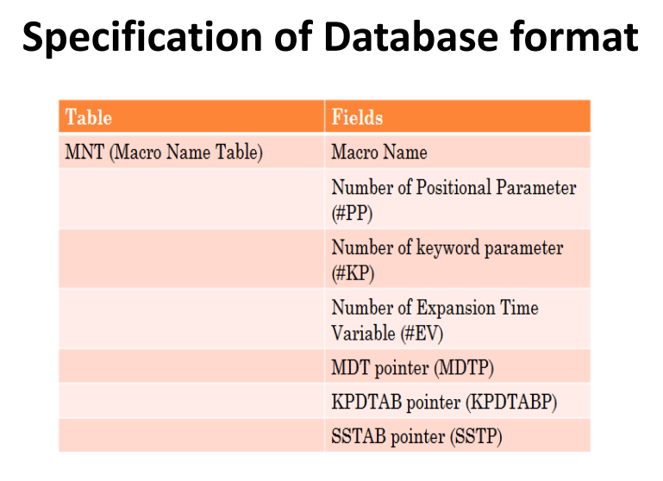
Dr. Mohit kumar (System Programming)

Slide 31
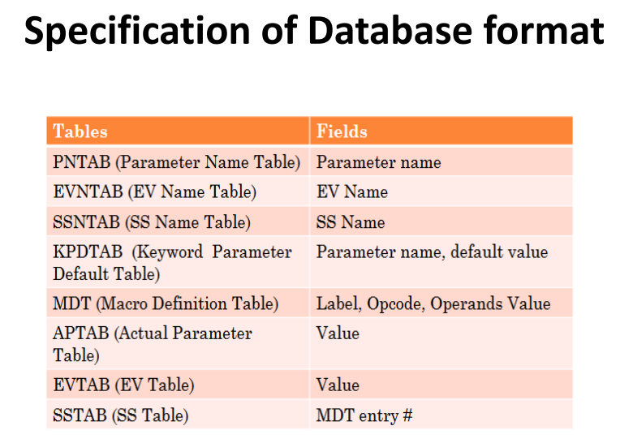
Dr. Mohit kumar (System Programming)

Slide 32
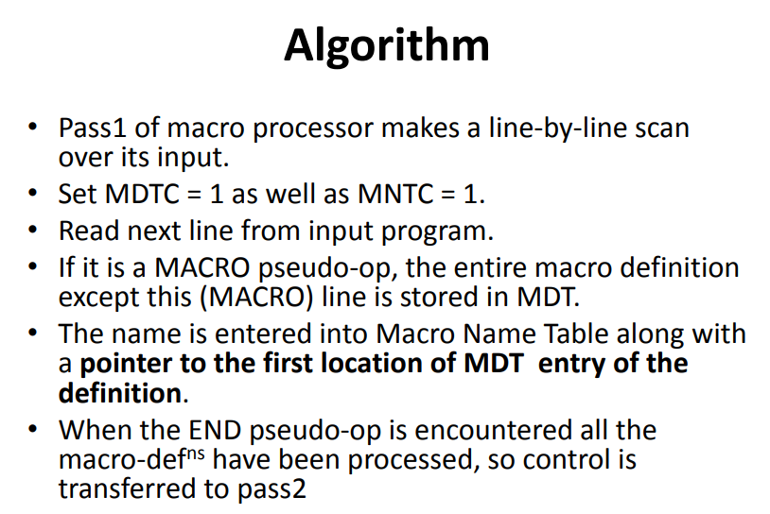
Dr. Mohit kumar (System Programming)

Slide 33
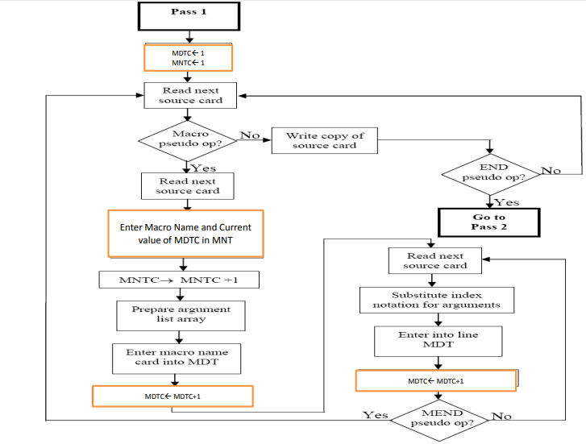
Pass 1 flowchart

Slide 34
Algorithm for Pass – 2
This algorithm reads one line of i/p prog. at a time.
• for each Line it checks if op-code of that line matches any of the MNT entry.
• When match is found (i.e. when call is pointer called MDTF to corresponding macro defns stored in MDT.
• The initial value of MDTP is obtained from MDT index field of MNT entry.
• The macro expander prepares the ALA consisting of a table of dummy argument indices & corresponding arguments to the call.
• Reading proceeds from the MDT, as each successive line is read, The values form the argument list one substituted for dummy arguments indices in the macro defn .
• Reading MEND line in MDT terminates expansion of macro & scanning continues from the input file.
• When END pseudo-op encountered , the expanded source program is given to the assembler
Mohit kumar (System Programming)

Slide 35
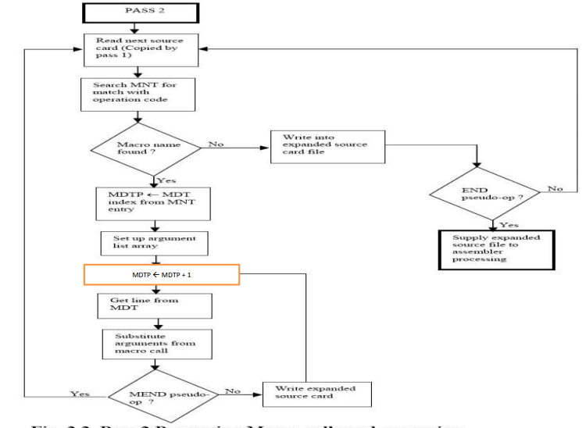
Pass 2 flowchart

Slide 36
End of Macros and Macro Processors unit

